Slide 1
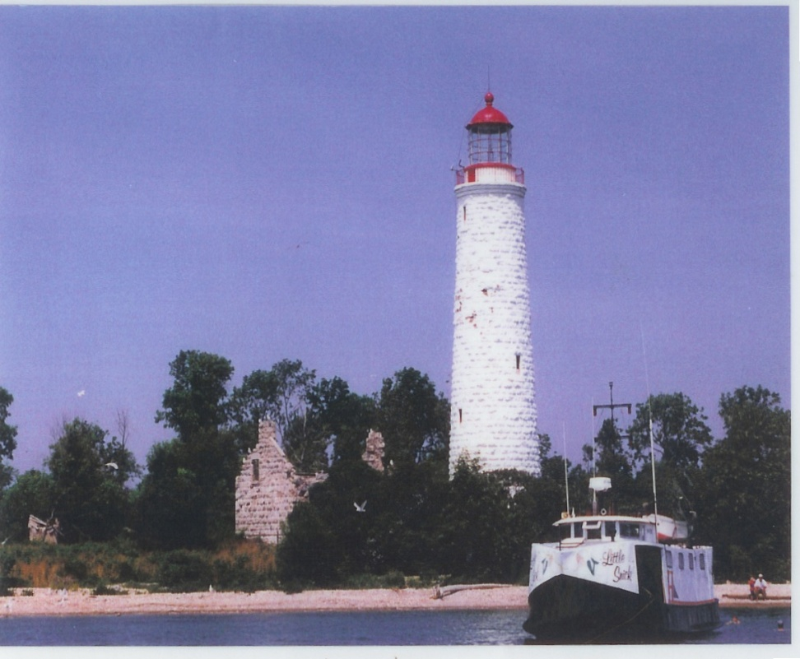
Chantry Island
1997

Slide 2
The Marine Heritage Society is a not for profit group of volunteers dedicated to the preservation and enhancement of our Marine History. The objective of the Society is to identify, preserve and restore material items of marine historical significance and to raise sufficient funds to support these endeavors.
Chantry Island Project
1997-2013

Slide 3
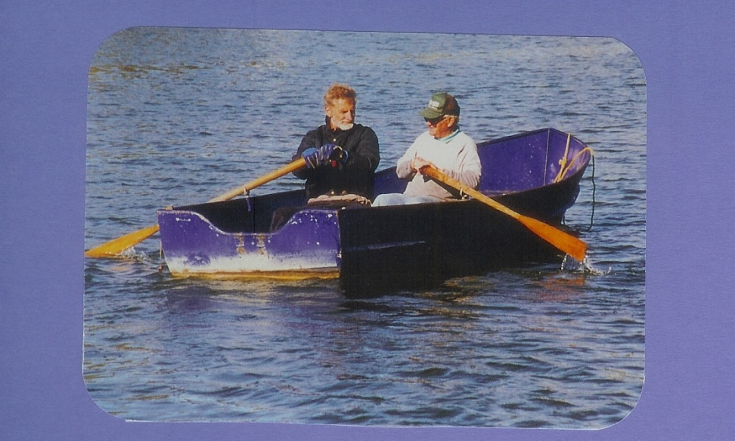
Mike Sterling and Bob Trelford project Managers
In 1997 our group travelled to Chantry Island and started a complete restoration of the Keepers Cottage.
After 1956 the Light was automated and it was no longer necessary for the Keepers and their families to live on the Island. It did not take long to fall to ruin.

Slide 4
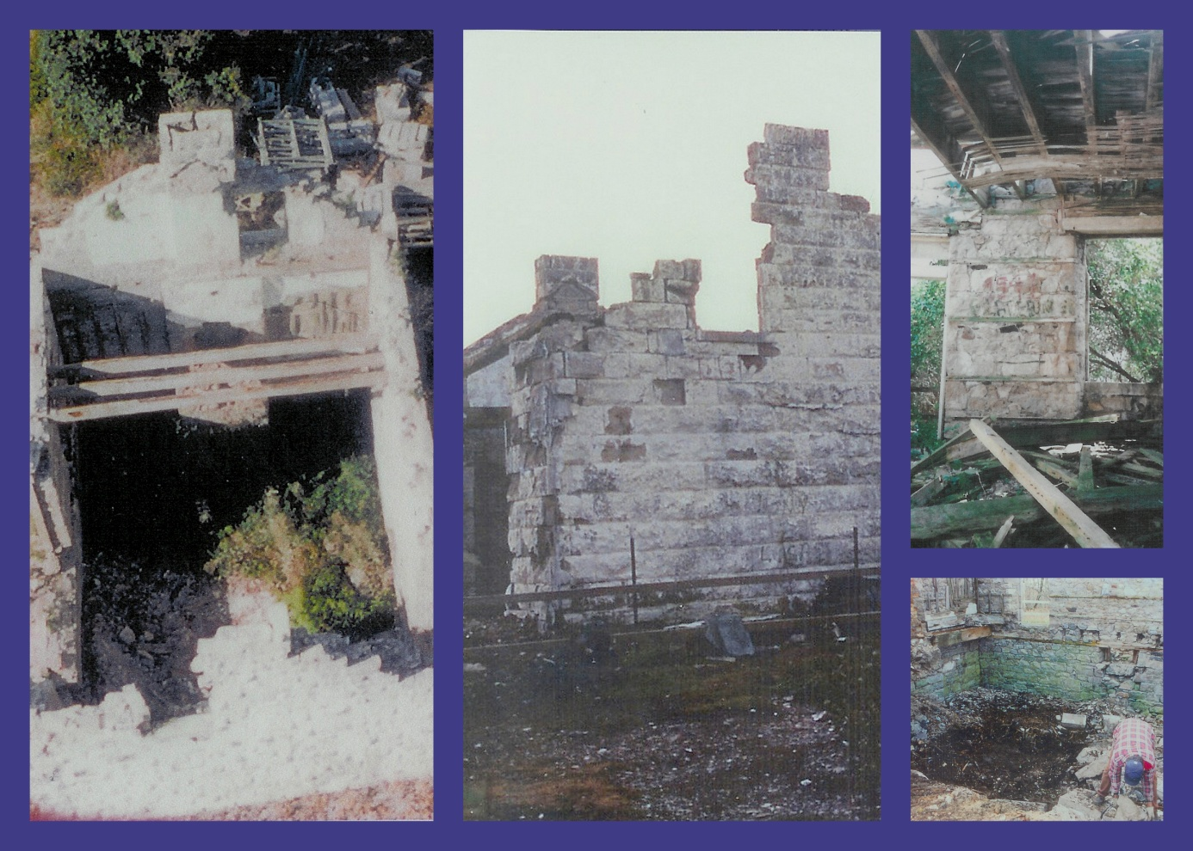
The cottage roof had fallen in and walls and floors had crumbled into a pile of rubble in the basement. With permission from 5 levels of government our group was able to find the original plans to rebuild the Keepers cottage.

Slide 5
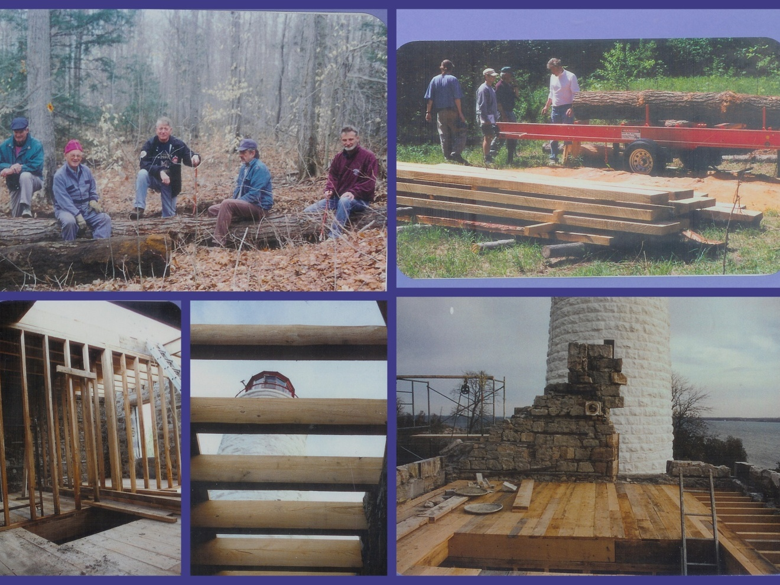
Timbers needed were not available at the local Lumber Yard so we cut down Hemlock trees from the Trelford farm and milled our own wood.

Slide 6
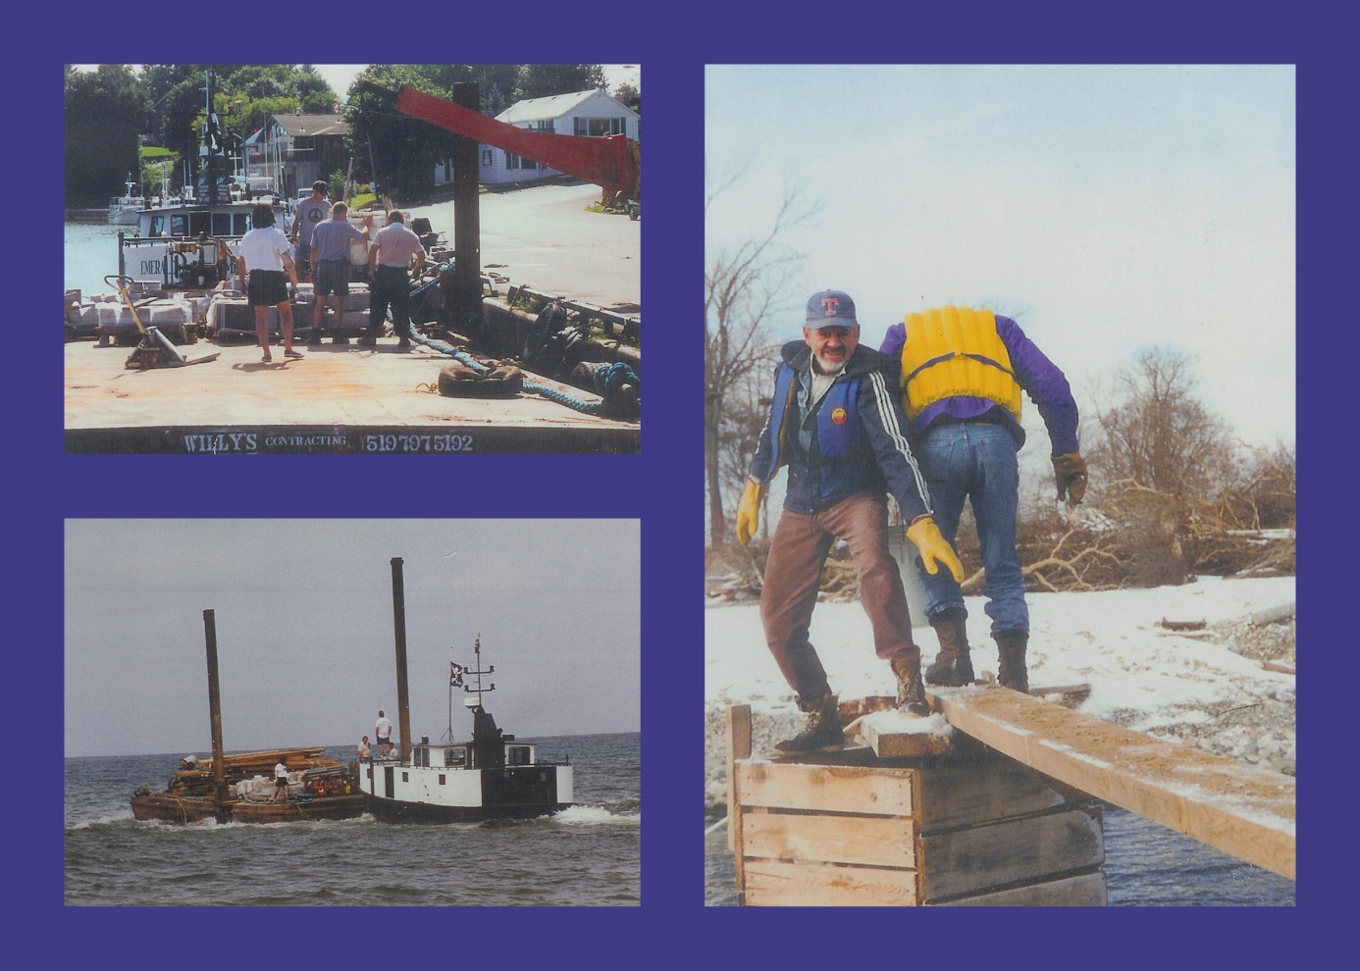
Supplies were taken by Willy’s barge. Our dock was a bit of a challenge when transferring the supplies from the barge onto the Island.

Slide 7
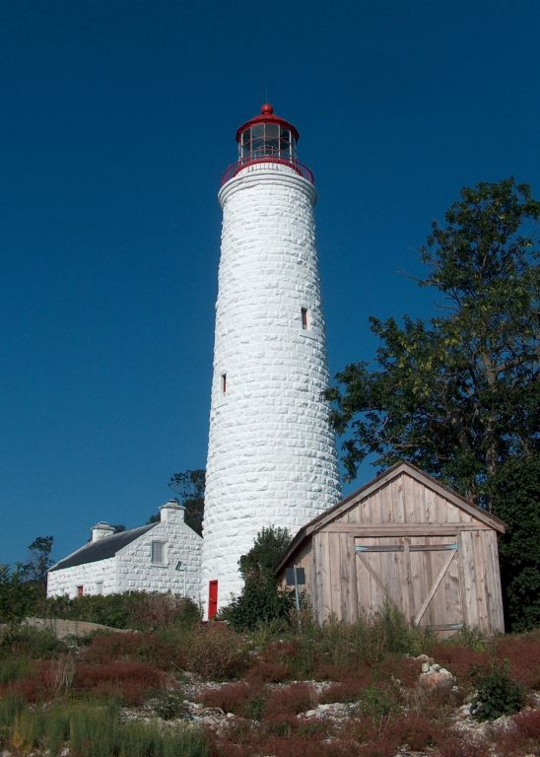
In August of 2001 we took the past Lighthouse Keepers Families as the first tour to the newly restored Keepers Cottage.
We offer tours all summer to Chantry Island and have taken over 12,000 people to enjoy our hard work.
Each year we enhance the tour with additional work done to the island. There is a new boat house and replica wooden boat inside built by volunteers.
2010

Slide 8
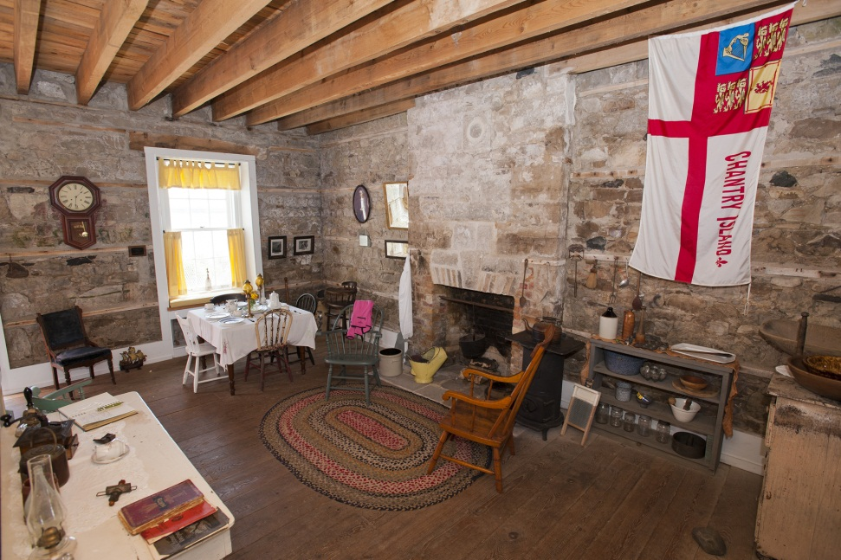
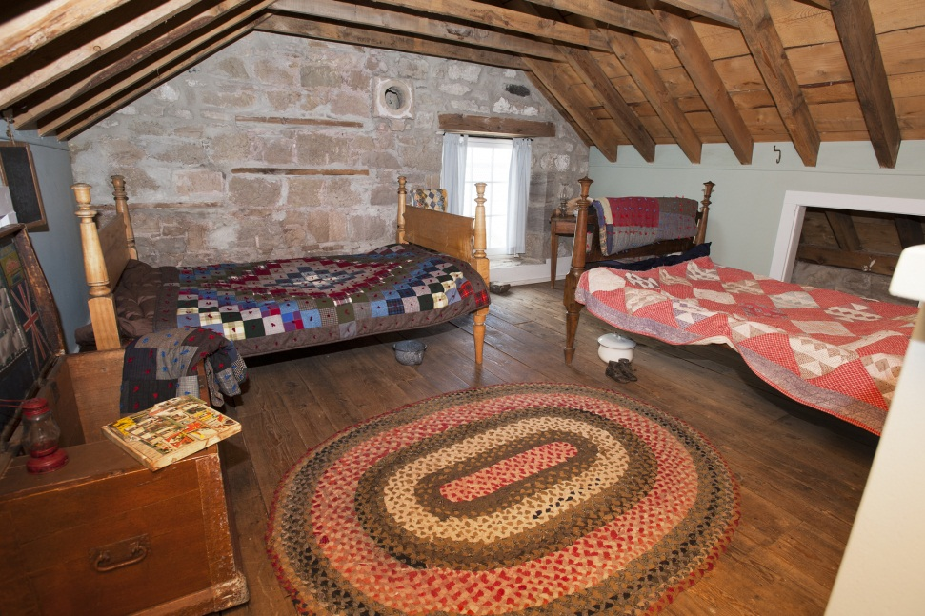
Inside the cottage we have a kitchen, keepers bedroom a parlour and loft decorated with period furnishings some donated and others from the Bruce County Museum.
In the loft there was lots of room for the children to sleep.
In the kitchen is the Chantry Flag and the Rumford fireplace.

Slide 9
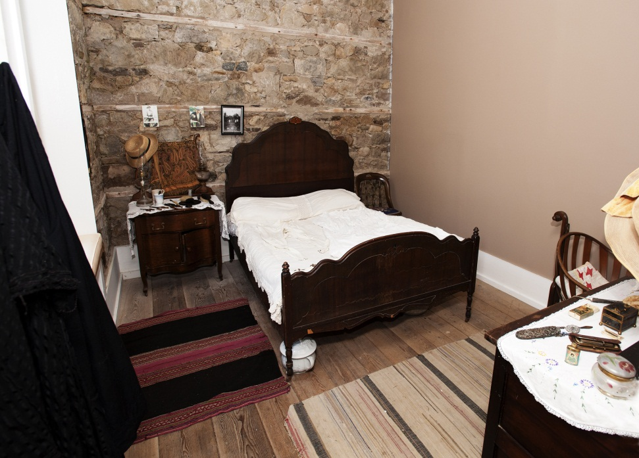
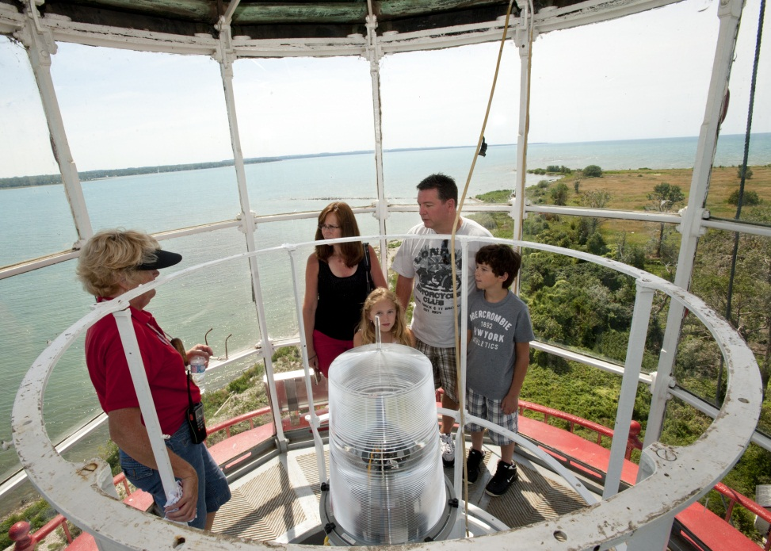
Keepers bedroom decorated with period furnishings from the mid 1800’s
Climb the 106 steps to reach the top of the Magestic Imperial Tower.

Slide 10
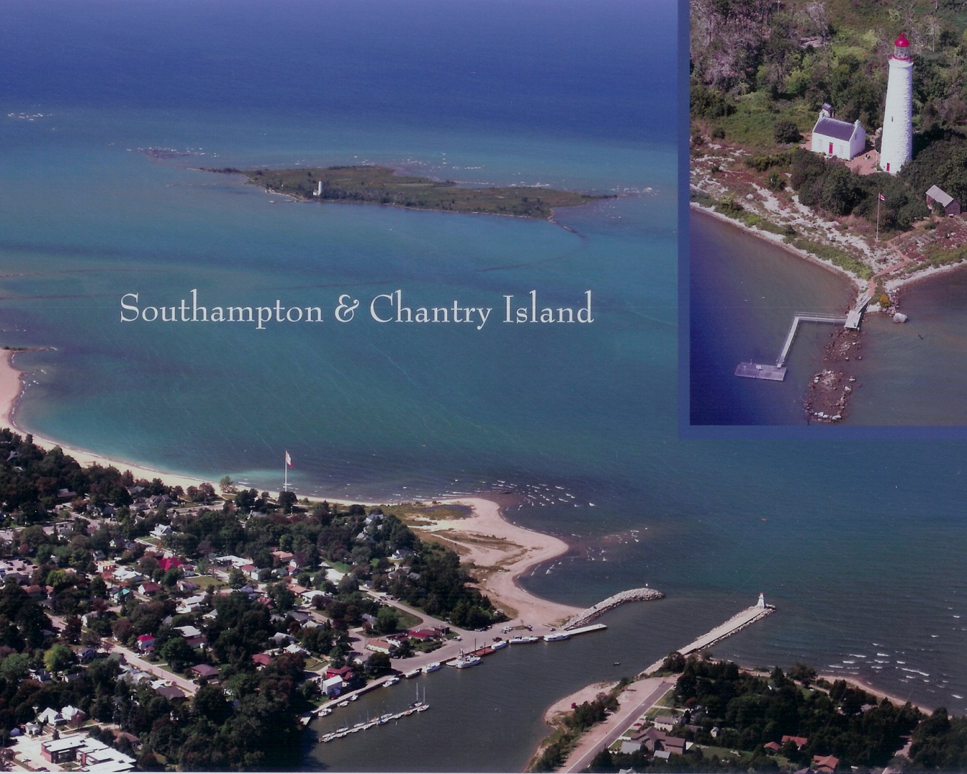
How to get to Chantry Island

Slide 11
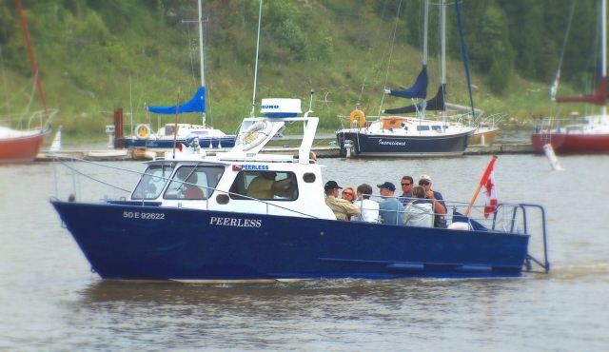
Peerless Tour Boat
Our 1970’s tour boat was found stored away in a shed , it was formerly used as the Water Rescue Boat. We spent numerous hours getting it ready for tours. After many years of use we ordered a new boat to start off our 10th year of tours to Chantry Island.

Slide 12
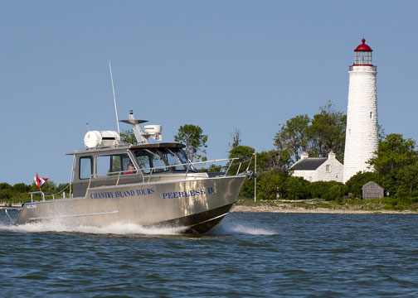
Peerless II arrives 2011

